Slide 1
PIZZA SALES

Slide 2
INTRODUCTION
Pizza, a universally beloved dish, has become an integral part of the global culinary landscape. Originating from Italy, pizza has evolved into a diverse array of styles and flavors, captivating taste buds across various cultures and regions. The popularity of pizza is not only reflected in its ubiquitous presence in restaurants and homes but also in its significant impact on the food industry and economy.

Slide 3
Hi Priyanka Kandalkar! In this project, you have utilized SQL queries to analyze and manage pizza sales data. This section will provide a detailed explanation of a sample SQL query that could be used to gain insights from a pizza sales database.

Slide 4

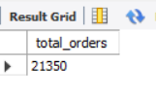
Retrieve the total number of orders placed.

Slide 5
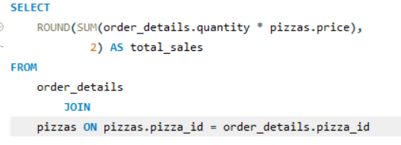

Calculate the total revenue generated from pizza sales.

Slide 6
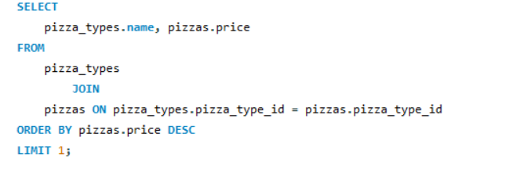
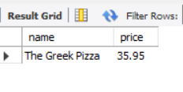
Identify the highest-priced pizza.

Slide 7
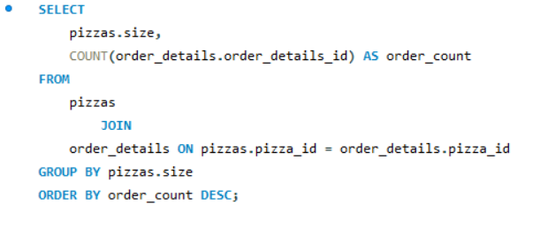
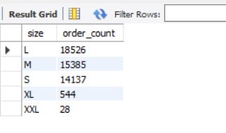
Identify the most common pizza size ordered.

Slide 8
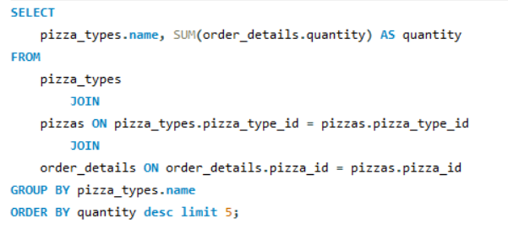
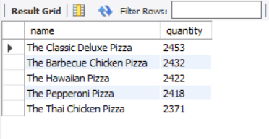
List the top 5 most ordered pizza types along with their quantities.

Slide 9
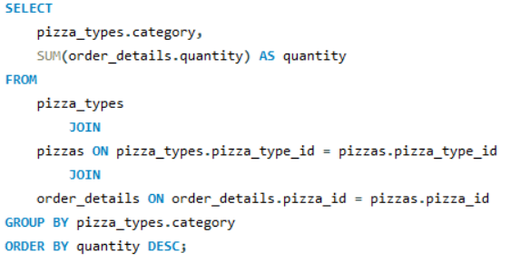
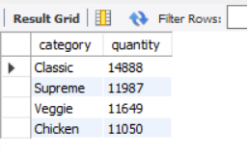
Join the necessary tables to find the total quantity of each pizza category ordered.

Slide 10
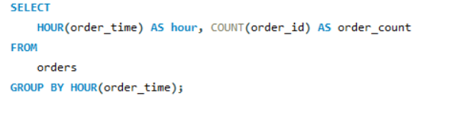
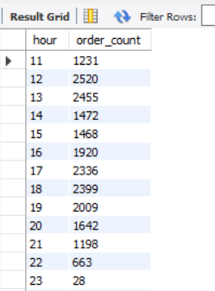
Determine the distribution of orders by hour of the day.

Slide 11

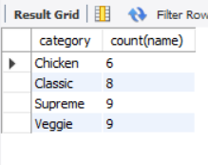
Join relevant tables to find the category-wise distribution of pizzas.

Slide 12
THANK YOU

